Slide 1
Lecture No. 1 Electrochemistry
At the end of this lecture, students will be able to:
Explain the need of electrochemical energy systems
Discuss oxidation and reduction reactions
Describe the origin of electrode potential

Slide 2
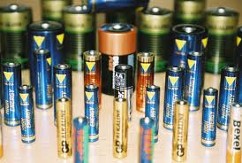
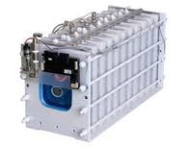
Electrochemical Energy Conversion and Need
Electrochemical energy conversion is a field of energy technology concerned with electrochemical methods of energy conversion including fuel cells and photoelectrochemical cells
This field of technology also includes electrical storage devices like batteries and supercapacitors

Slide 3
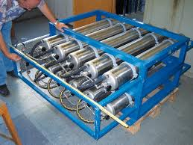
Electrochemical Energy Conversion – Need
Powerful storage devices are required for automotive propulsion systems
There has been the creation of more powerful, longer running batteries allowing longer run times for electric vehicles
With upsurge of electronic industry the demand is ever increasing for smaller and efficient storage devices

Slide 4
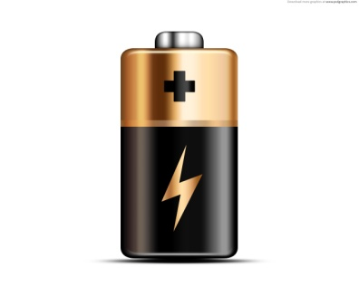
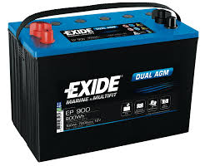
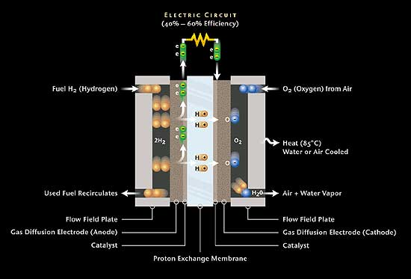
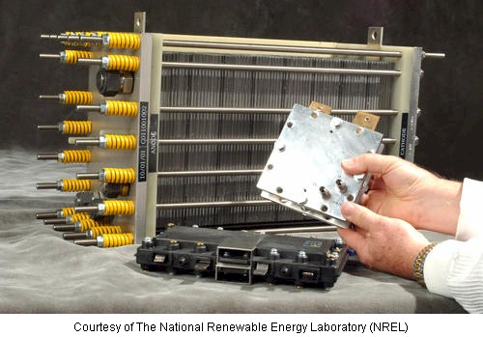
Various Storage and Energy Conversion Devices
Batteries – Zn-MnO₂ battery (dry cell), Rechargeable Lead acid battery, Ni-Cd battery, Ni-MH Baterry, Lithium ion batteries, etc.
Fuel Cells – H₂O₂ fuel cell, Methanol-
Oxygen fuel cell, Polymer electrolyte fuel cell, etc.

Slide 5
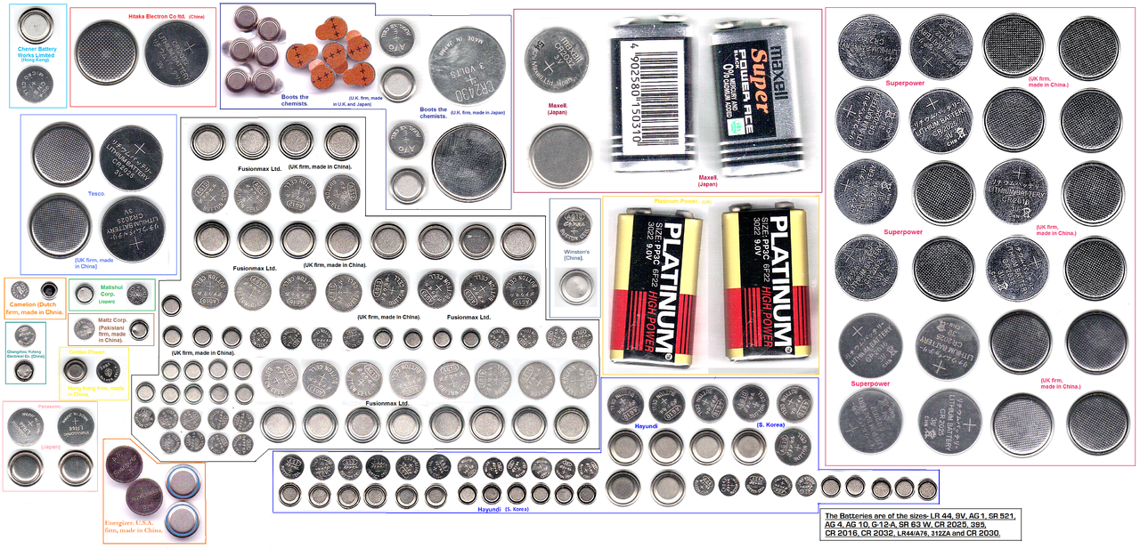
Various Storage and Energy Conversion Devices
Miniaturization of electrochemical devices is the need of day to suit requirement of electronic industry

Slide 6
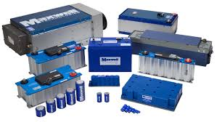
Various Storage and Energy Conversion Devices
Super Capacitors –
Double-layer capacitors – with carbon electrodes or derivates with much higher electrostatic double-layer capacitance than electrochemical pseudocapacitance
Pseudocapacitance – with metal oxide or conducting polymer electrodes with a high amount of electrochemical pseudocapacitance
Hybrid capacitors – capacitors with asymmetric electrodes, one of which exhibits mostly electrostatic and the other mostly electrochemical capacitance, such as lithium-ion capacitors

Slide 7
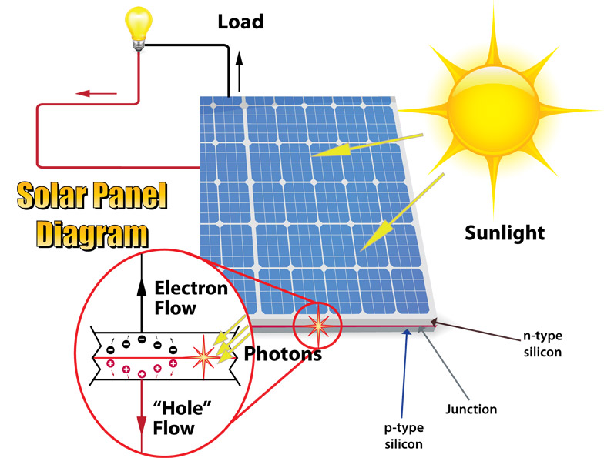
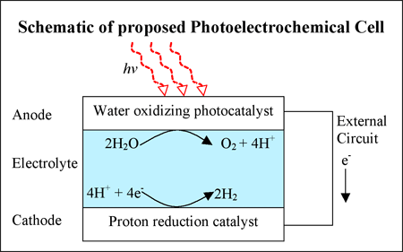
Various Storage and Energy Conversion Devices
Photoelectrochemical Cells – PECs are solar cells that produce electrical energy or hydrogen in a process similar to the electrolysis of water

Slide 8
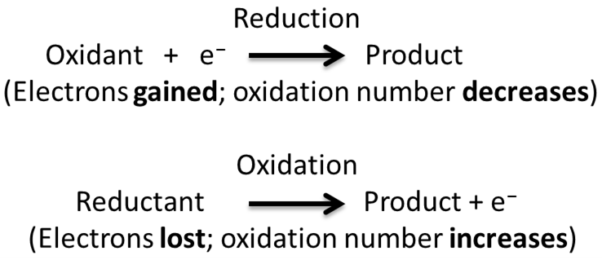
Electrode Potential and Cells
Oxidation is the loss of electrons or an increase in oxidation state by a molecule, atom, or ion
Reduction is the gain of electrons or a decrease in oxidation state by a molecule, atom, or ion

Slide 9

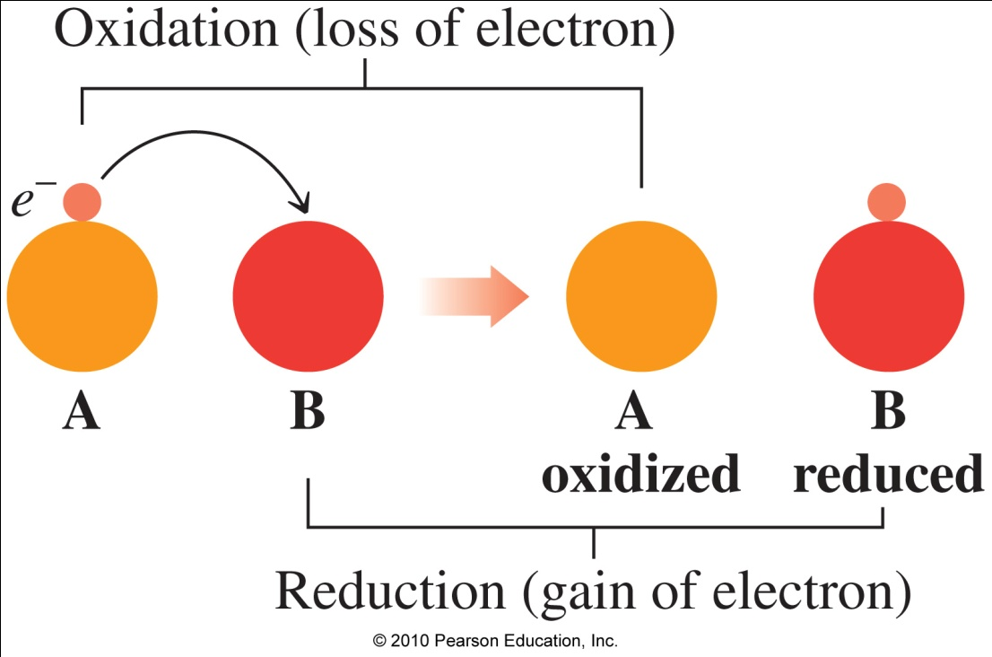
Electrode Potential and Cells
An oxidation–reduction reaction
Provides us with energy from food
Provides electrical energy in batteries
Occurs when iron rusts
4Fe(s) + 3O₂(g)  2Fe₂O₃(s)

Slide 10
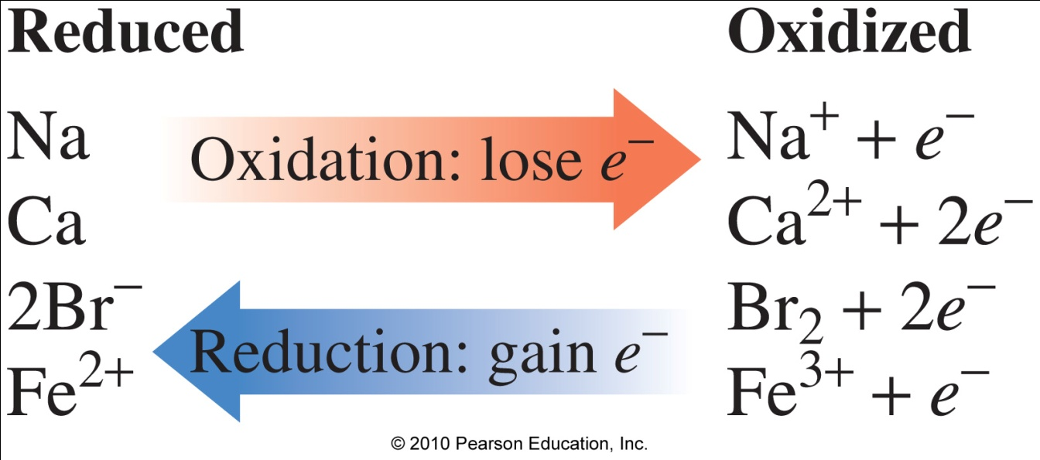
Oxidized or Reduced?

Slide 11
Electrode Potential and Cells
Zn and Cu²⁺
oxidation
Zn(s)  Zn²⁺(aq) + 2e-
Silvery metal
reduction
Cu²⁺(aq) + 2e-  Cu(s)
CuSO₄ solution is present in the beaker

Slide 12
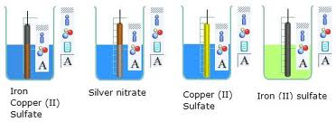
Electrode Potential and Cells
Standard Electrode Potential (Eº): Potential developed when a metal is dipped in a solution of its own ions of unit molar concentration at 298 K is called as Standard electrode potential and is represented as Eº
Electrode potential (E) in electrochemistry, according to an IUPAC definition, is the electromotive force of a cell built of two electrodes
Potential developed when an element is in equilibrium with its ionic solution is called single electrode potential. It is denoted by E
Ex: Cu rod in Cu²⁺ ions (CuSO₄ solution)
Zn rod in Zn²⁺ ions (ZnSO₄ solution)

Slide 13
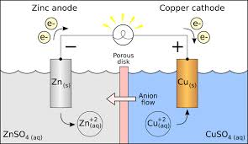
How Electrode Potential is Originated ?
When a metal is placed in a solution containing its own ions, it exhibits two types of tendencies
Metal shows the tendency to go into the solution as metal ions by liberating electrons is called oxidation or dissolution reaction
M → M^{n+} + ne
Zn → Zn²⁺ + 2e

Slide 14
How Electrode Potential is Originated ?
Metal ions in the solution show the tendency to get deposited on the metal surface as metal atom by gaining electrons is called reduction or deposition reaction
M^{n+} + ne → M
Cu²⁺ + 2e → Cu
How deposition takes place?
After some time the dissolution and deposition reactions attain a state of equilibrium
M  M^{n+} + ne

Slide 15
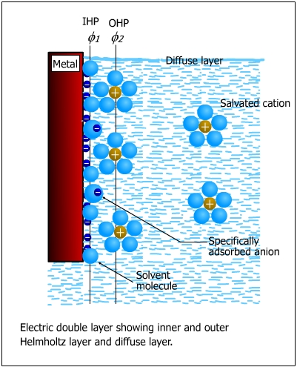
How Electrode Potential is Originated ?
Inner Helmholtz layer - potential changes linearly with the distance
Comprises the absorbed water molecules and sometimes the specifically adsorbed anions
Outer Helmholtz layer Comprises hydrated (solvated) cations - potential varies linearly with the distance
Outer diffuse layer, also called the Guoy-Chapman layer, which contains excess cations or anions distributed in a diffuse layer - potential varies exponentially with the distance, F

Slide 16
Summary
Need of electrochemical energy systems: Industrialization, electric vehicles, propulsion systems, etc.
Oxidation is the loss of electrons or an increase in oxidation state by a molecule, atom, or ion
Reduction is the gain of electrons or a decrease in oxidation state by a molecule, atom, or ion
Origination of electrode potential: occurs due to Helmholtz double layer

